Slide 1
Hackathon Getting Started

Slide 2
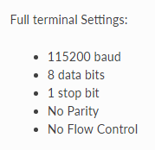
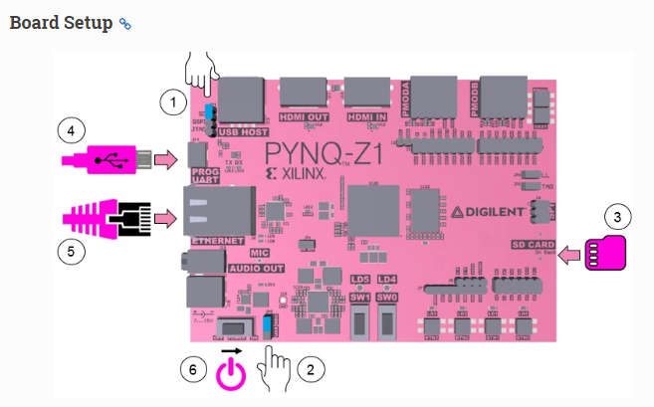
1
Serial
3
Board wlan0
on securebrd
IP addressing best, name resolution possible
2
Board Eth0 IP
Static IP
192.168.2.99
Three ways to connect! Let’s do them all….

Slide 3
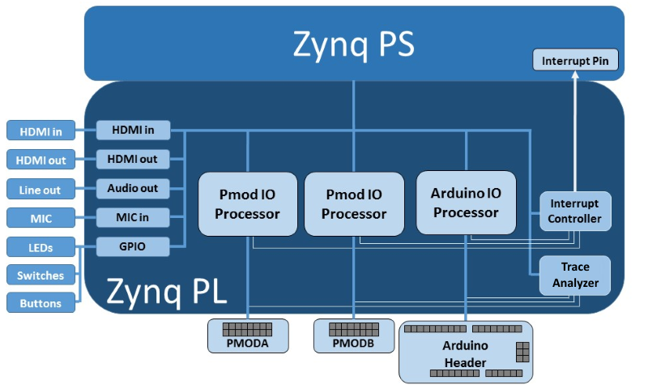
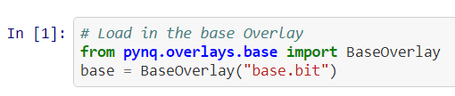

PYNQ Overlays: Base
Cool things to explore
Programmable soft processors from Jupyter
Waveform analysis on PMODs / Arduinos
Programmable Video Pipeline
Video
PMODs
Arduino
Audio
GPIO
Project Ideas
Sensor fusion
Self-driving robot
Video integration & the cloud
Alexa
Trace
Analyzer

Slide 4
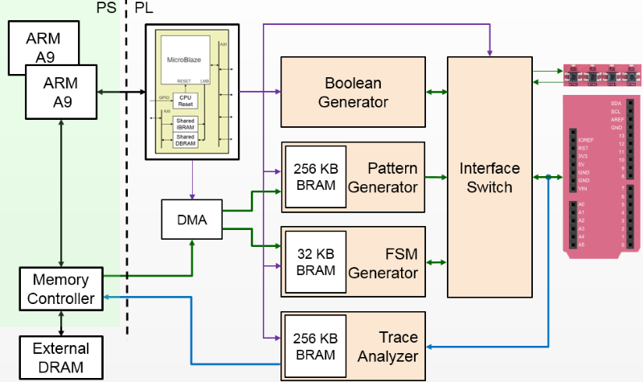
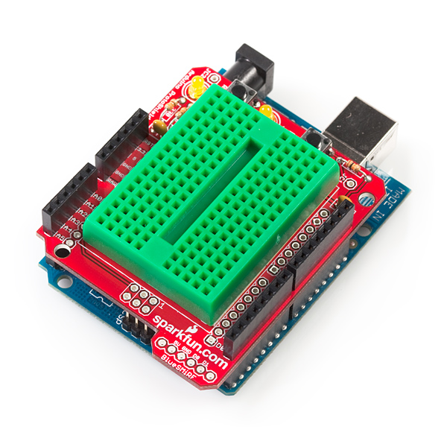
PYNQ Overlays: Logictools
ProtoShield Kit
Protocol Analysis (UART, I2S, 1-Wire, PWM/PPM)
Interactive JavaScript state machine table entry
Multi-bit sine wave, square wave, other waveform generation into external DAC?
White-noise generator (PRBS)

Slide 5
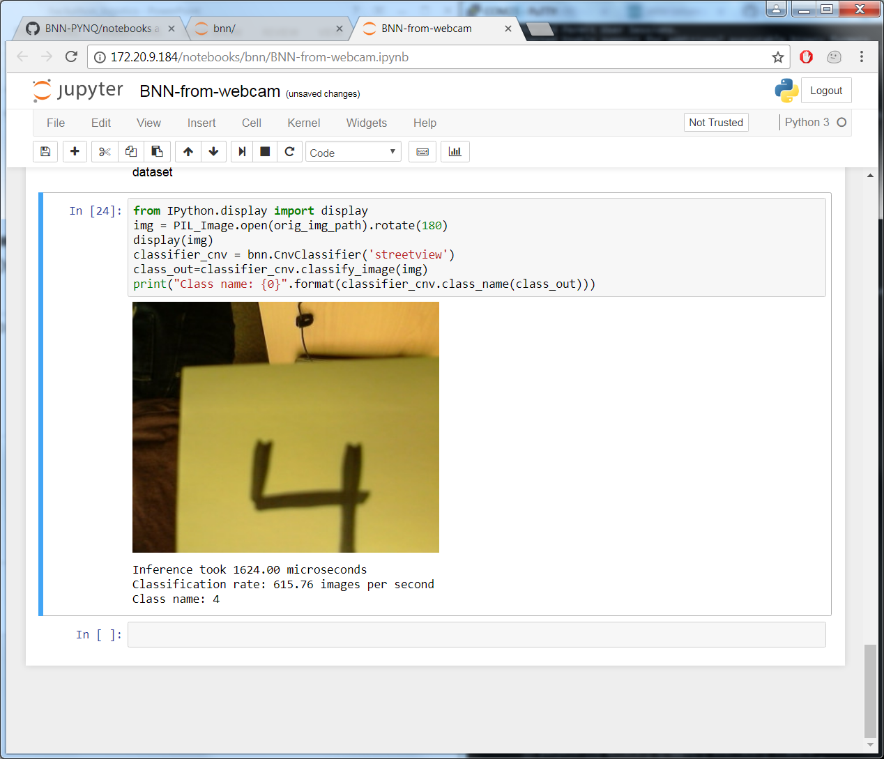
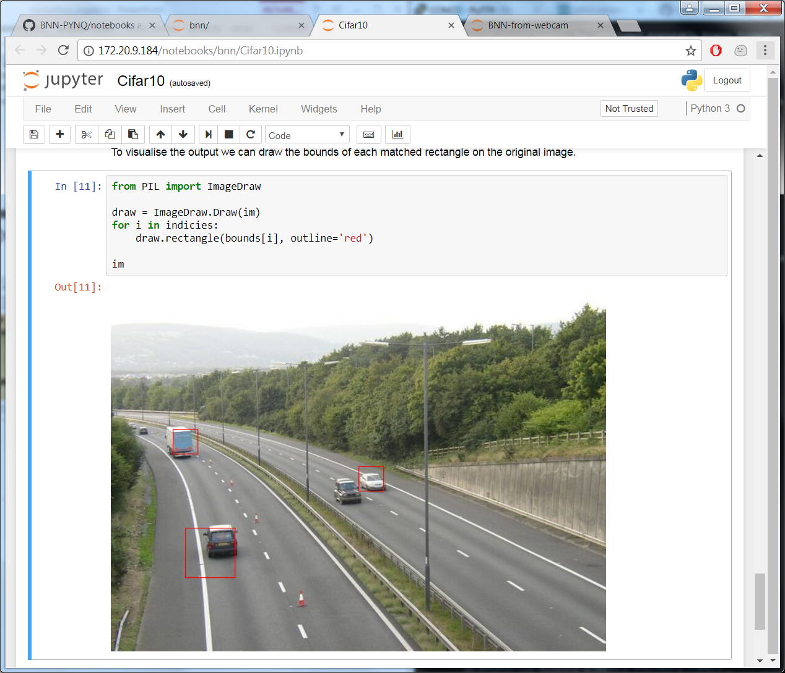
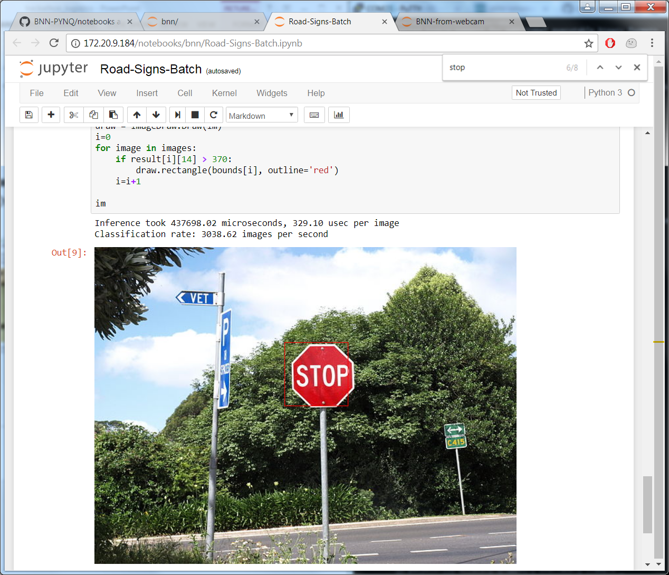
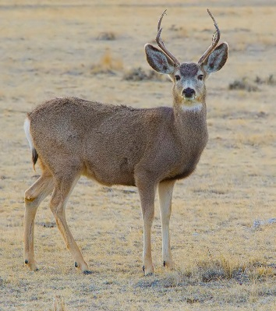
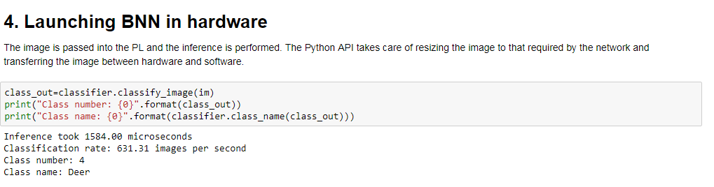
PYNQ Overlays: Binary Neural Network
Cool things to explore
Neural networks are cool by definition
Project Ideas
Integrate classification with webcam
Classify, swap bitstream, display on video

Slide 6
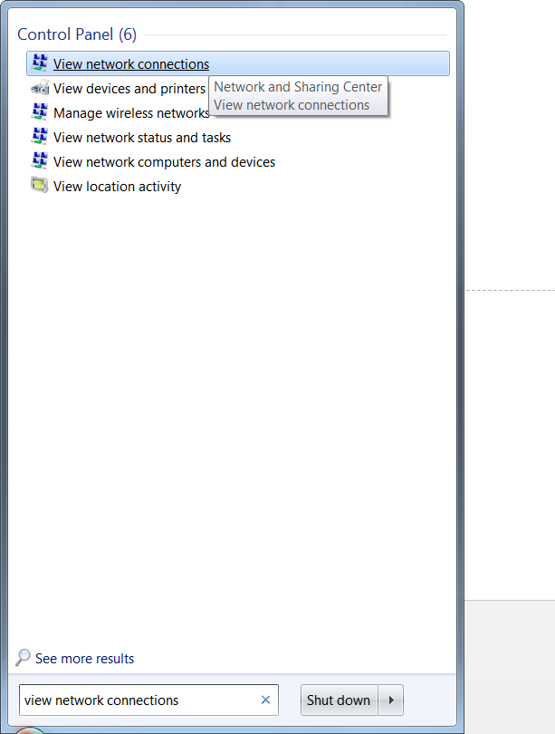
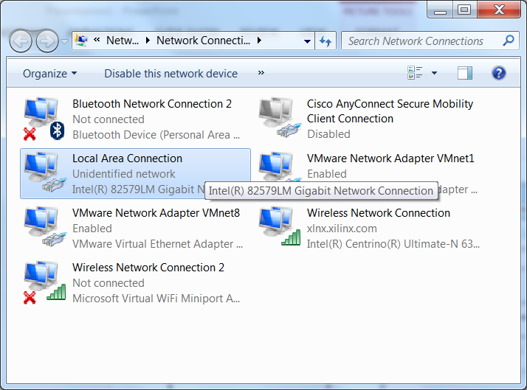
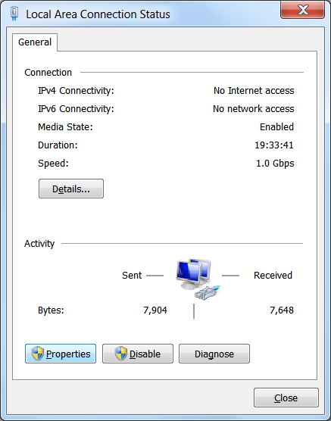
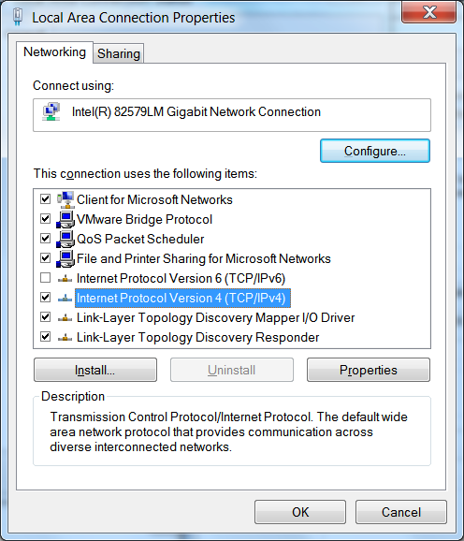
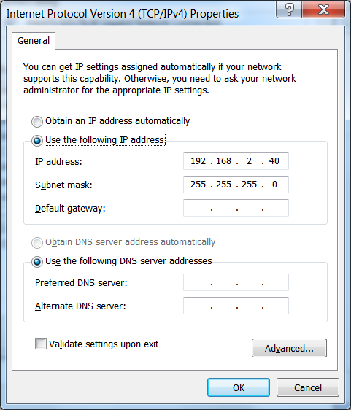
1. Type “View Network Connections” in the start menu
2. Select “Local Area Connection” from the explorer window
3. Click “Properties”
5. Click “TCP/IPv4”
6. Match the settings above

Slide 7
